Slide 1
JENKINS
VIKAS
Notes:
Create web page :
mvn archetype:generate -DgroupId=com.sample.webproject -DartifactId=SampleWebApp -DarchetypeArtifactId=maven-archetype-webapp -DinteractiveMode=false
https://www.studytonight.com/maven/maven-web-application
https://docs.github.com/en/github/authenticating-to-github/keeping-your-account-and-data-secure/creating-a-personal-access-token

Slide 2
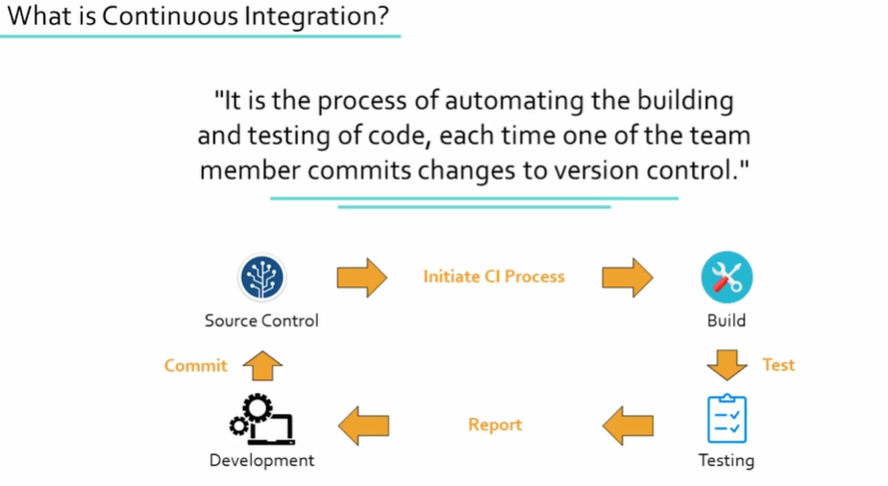
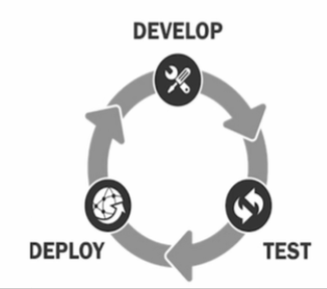
Notes:
Benefits :
Improve quality
Increase productivity
Reduce risk
Detect errors quickly & locate them easily.
Developers Integrate there code several times in a day.
https://aws.amazon.com/devops/continuous-integration/
https://docs.aws.amazon.com/AWSEC2/latest/UserGuide/install-software.html
What is Yum? yum is the primary tool for getting, installing, deleting, querying, and managing software Packages

Slide 3
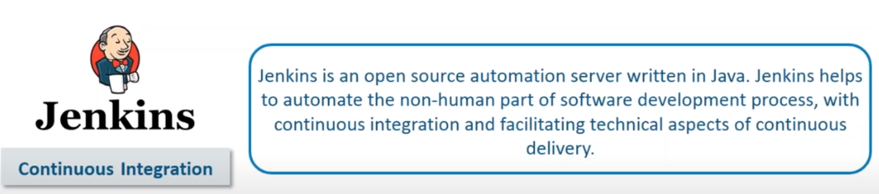
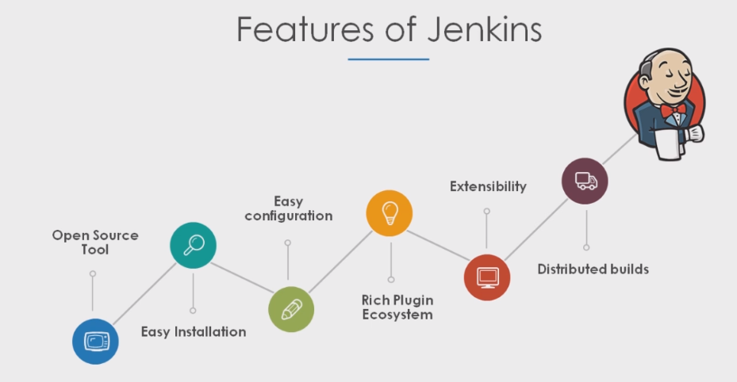
Notes:
If CI tool(Jenkins) is not their Sys admin has to do all this action multiple times
With Jenkins you can -- > clone project + build + test + report + package + deploy + notify .
CI/CD pipeline is a strategy through which new features are delivered to users in a fast and efficient manner .
Benefits :
Easy to set up & configure
Extendible via plugins
Distributed in nature (Master slave architecture) .
Jenkins's script uses groovy in background.
Steps Involved in developing a product/Software :
Plan the procedure
Write code for functionality
Make the code executable
Run Tests
Run software on client system
Monitor the work software and get regular feedback .

Slide 4
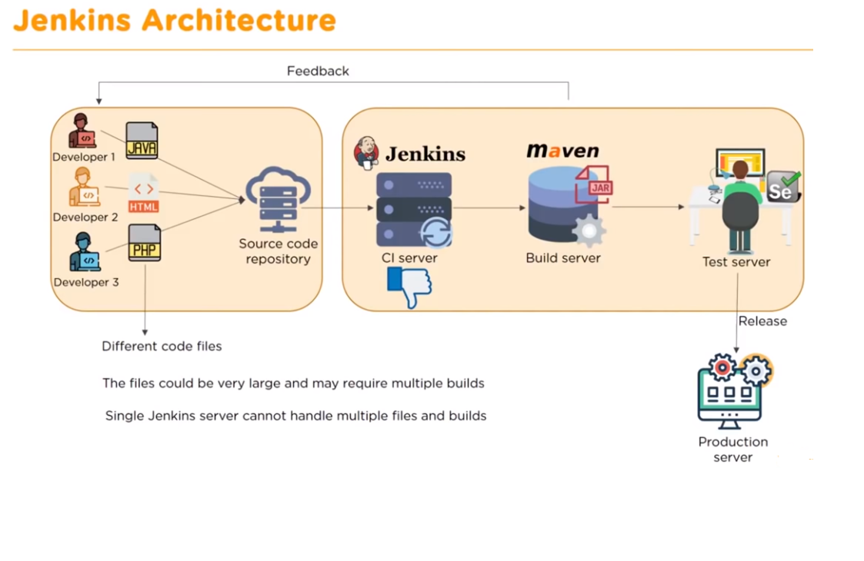
Notes:
Sample Script :
#!/bin/bash
username=$1
password=$2
if[[ "$username" = "jenkins" && "$password" = "password123" ]]; then
echo " Your credentials are correct "
else
echo " Invalid Credentials "
Fi
On Jenkins : <full path >/script.sh $username $ password

Slide 5
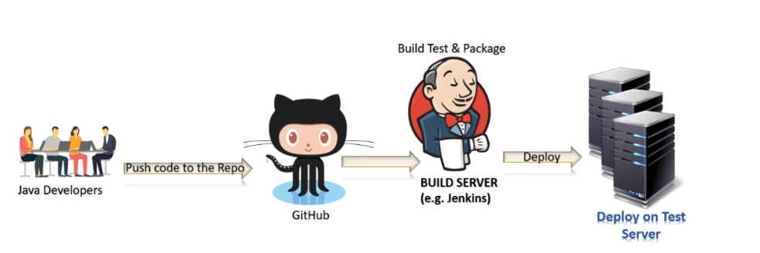
Notes:
To run on a different port : java -jar jenkins.war --httpdPort=8181
Prerequisites :
JDK 1.7 or 1.8
2 GB ram
Set JAVA_HOME Path
Jenkins's installation
---------------------
yum install -y wget
sudo wget -O /etc/yum.repos.d/jenkins.repo http://pkg.jenkins-ci.org/redhat/jenkins.repo sudo rpm --import https://jenkins-ci.org/redhat/jenkins-ci.org.key
yum install Jenkins
service jenkins status
service jenkins start / systemctl start Jenkins
chkconfig Jenkins on
Create a Jenkins user and login
Manage Maven Installation :
-------------------------------
cd /root
ls –la
vi .bash_profile →
# User specific environment and startup programs
JAVA_HOME=/usr/lib/jvm/java-1.8.0-openjdk-1.8.0.222.b10-0.amzn2.0.1.x86_64
M2_HOME=/opt/apache-maven-3.6.3
M2=$M2_HOME/bin
PATH=$PATH:$JAVA_HOME:$M2_HOME:$M2:$HOME/bin
export PATH
wq!
[root@ip-172-31-34-218 ~]# echo $PATH
/sbin:/bin:/usr/sbin:/usr/bin:/usr/lib/jvm/java-1.8.0-openjdk-1.8.0.222.b10-0.el8_0.x86_64:/root/bin
Exit and start again and then source ~/.bash_profile →echo $PATH
Now go to manage plugins → install maven invoker, maven integration and git hub→ Wait for installation
On Jenkins Web : global tool configuration → add JDK → NAME =Java-1.8 → Java home =/usr/lib/jvm/java-1.8.0-openjdk-1.8.0.222.b10-0.el8_0.x86_64
To get the link use command → [find / -name javac] or [find /usr/lib/jvm/java-1.8* | head –n 3] → echo $JAVA_HOME
Add Maven → /opt/maven/apache-maven-3.6.2
Add git path in Jenkins web
To make mvn work :
============================
Inside bin folder → vi ~/.bashrc
export M2_HOME=/opt/maven/apache-maven-3.6.3
export M2=$M2_HOME/bin
export PATH=$M2:$PATH
Reload using source ~/.bashrc
mvn --version

Slide 6
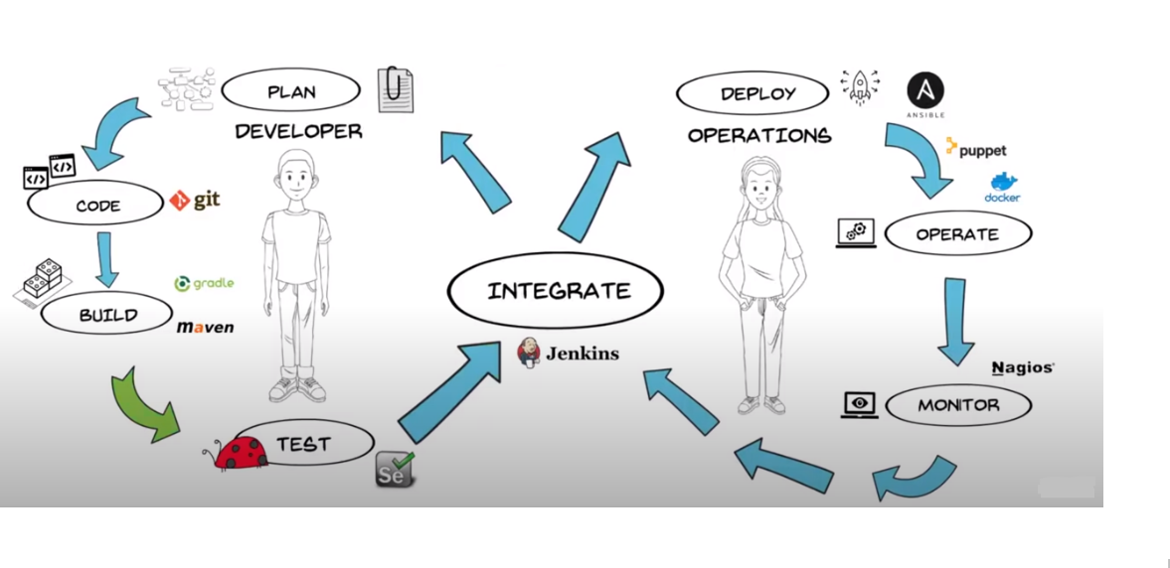
Notes:
Jenkins is an open-source automation tool written in JAVA which can be used to automate all sort of tasks ,related to building ,testing ,delivering and deploying the software ,with the wide variety of plugins available /Plugins allow Jenkins's integration of various Dev ops stages .
Other tools :
Bamboo
Travis CI
Buildbot
Gitlab CI
Apache Gump

Slide 7
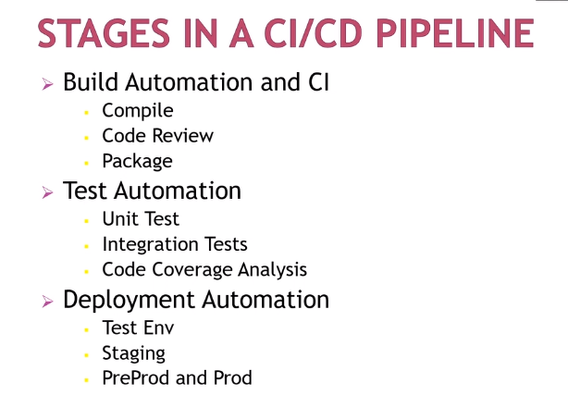
Notes:
Developer :
Clone the project -- > Code changes and commit the changes
Operation Team :
Clone the project -- > Build and Test -- > Code Analysis -- > Deployment

Slide 8
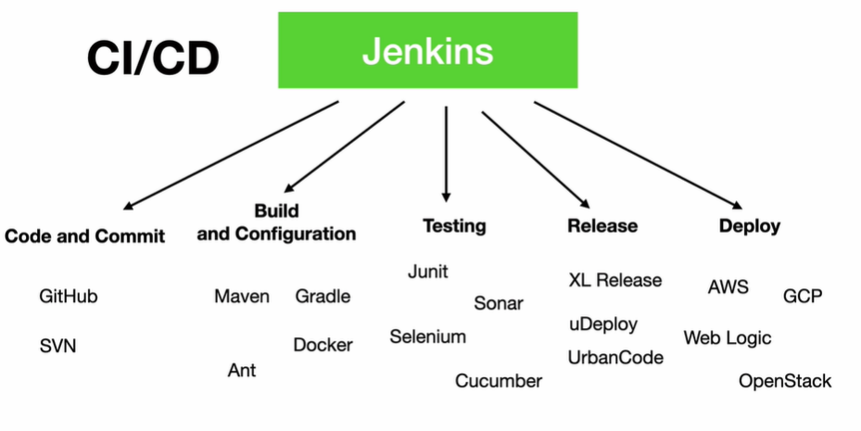
Notes:
Build Pipeline : Manage plugin --> build pipeline -- > once complete -- > new view -- > pipeine view -- > choose initial job and number of builds -- >
Invoke top level maven target -- > compile – JOB1
You can see the executables at /var/lib/Jenkins/workspace/<job name >
Invoke top level maven target -- > test – JOB2
if you need visual report -- > post build action -- > Publish Junit test report -- > gameoflife-web/target/surefire-report/*.xml -- > save and build
use post build action in build and build triggers -- > build after project ar build
To see pipeline view :
install build pipeline plugin -- > my view you will see the new view -- > build pipeline view -- > initial job -- > choose that -- > and start

Slide 9
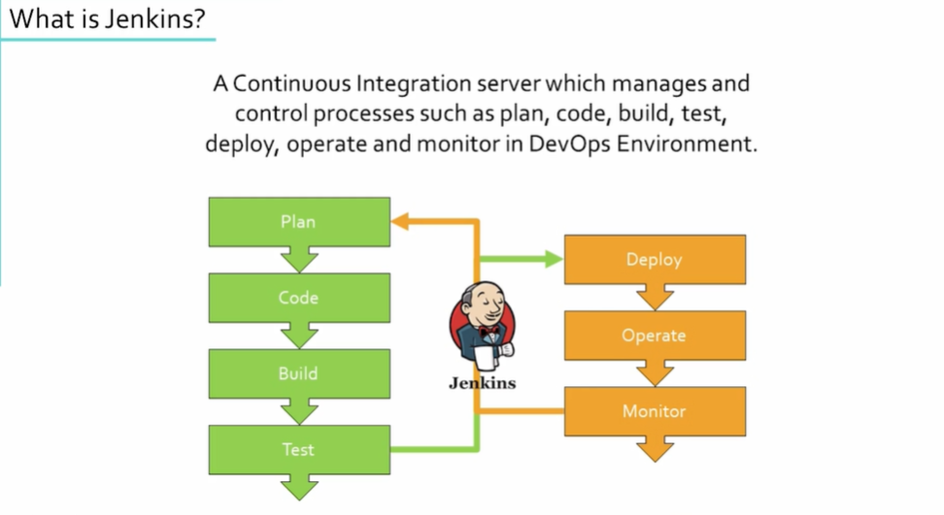
Notes:
Plugins -- > thin backup
-- > monitor view
-- > delivery pipeline
-- > poll scm -- > gmail settings -- > Forwarding and POP/IMAP -- > IMAP access -- > enable IMAP
-- > CloudBees Docker Build and publish plugin -- > create a freestyle project -- > build 1 (maven[clean + test + package [have Docker file in the git repo]]) -- > build 2 (Docker build and publish) -- > add registery credentials (user name + password)
Pipe line syntax – with credentials -- > add secret text --

Slide 10
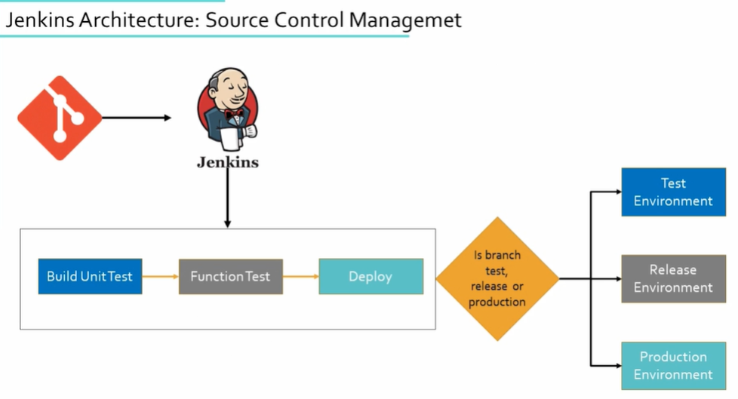
Notes:
Jenkins Terminology :
1. Job/project
2. Node
3, Executor
4. Build
5. Plugin

Slide 11
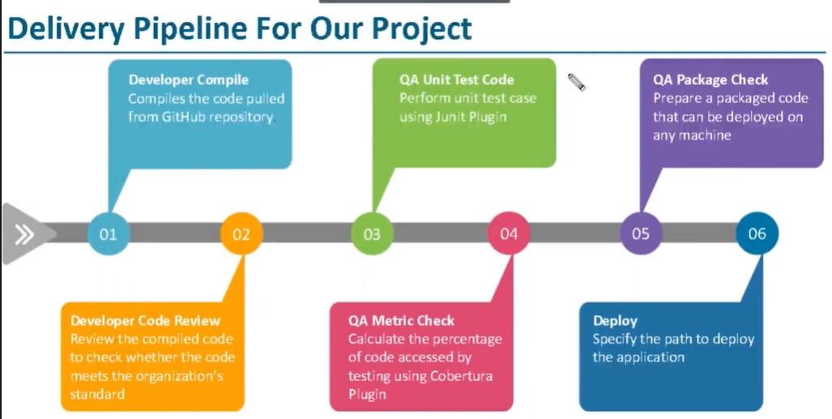
Notes:
Deploy static website from Git :
change to /bin/bash @root @ /etc/passwd
Enable Shell for jenkins User
vi /etc/passwd
2) Change group permission for Jenkins like
sudo user vi /etc/sudoers
jenkins ALL= NOPASSWD: ALL
3) sudo systemctl restart jenkins
Script :
---------
sudo apt install -y httpd
sudo systemctl restart httpd
sudo rm -rf /var/www/*
sudo rm -rf /var/www/html/.git
echo “<html><h1>This is a static web page </h1></html>” >> /var/www/html/index.html
=================================
echo “Current date is $(date) “
echo “User name provided is $USERNAME and your password is $PASSWORD “
=================================
Create a script name it as -- login.sh
#!/bin/bash
USERNAME=$1
PASSWORD=$2
if [[ ("$USERNAME" = "admin") && ("$PASSWORD" = "jenkins123")]] ;
then
echo " Credentials are correct !! Enjoy Scripting "
else
echo " Credentials are not correct !! "
fi
2. Please chmod +x to the script .
3. Check it on local
4. On Jenkins full path of the script $USERNAME $PASSWORD
Git hook - Web hook :
http://<jenkins-ip>:8080/github-webhook/
Content type : application /json -- > send me everything -- > add webhook
On jenkins : Github hook trigger to GITScm Polling

Slide 12
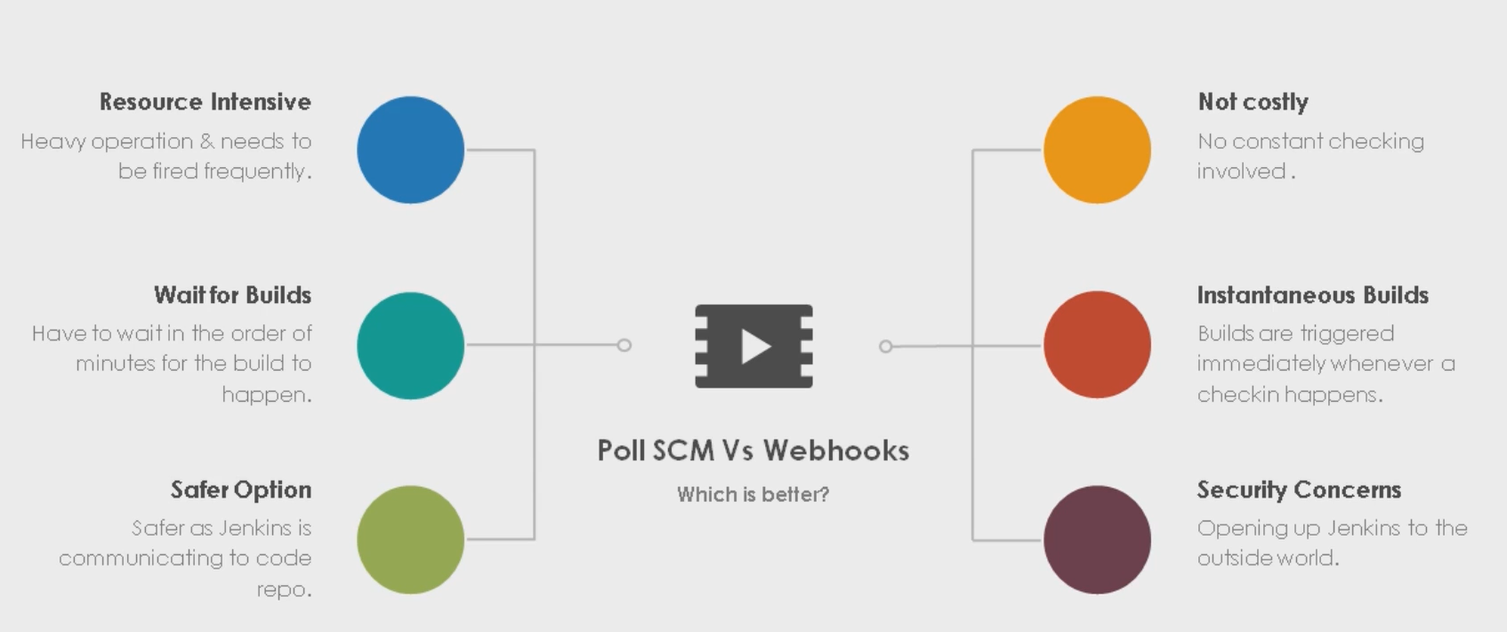

Slide 13
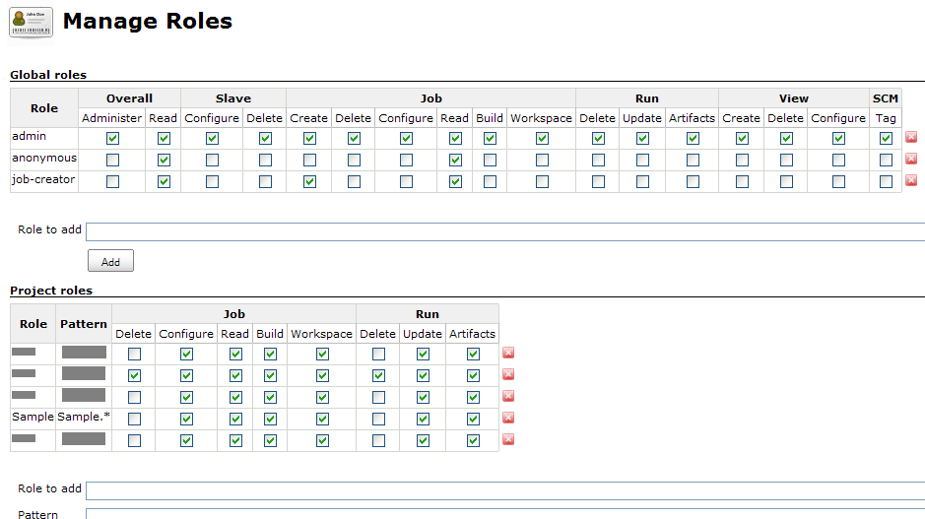
Notes:
Install Role based authorization strategy – plugin for user management
Configure global security – enable Role-Based Strategy after plugin is installed .save and continue .
Manage user – create users
Manage and assign roles – Mange roles – item roles (add developer and tester: pattern – dev.*,test.*)
Global Role – (add employee & some more )
Assign Role -- in global roles add user and group and add item roles also
Configure Global security : Markup formatter then edit System Message in configuration.

Slide 14
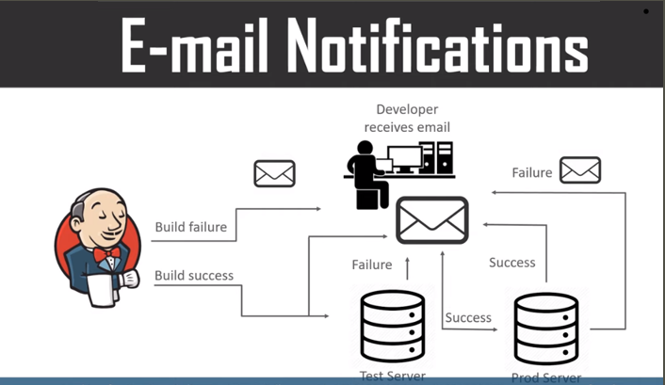
Notes:
Configure Email alert :
------------------------
Default Email Notified -- > Manage Jenkins -- > Configure system -- > E-Mail Notification -- >
SMTP Server -- > smtp.gmail.com
check on use SMTP Authentication -- > fill username(email id) -- > password -- > check on Use SSL -- > SMTP Port number -- > 465 -- > Test configuration
Post Build Action -- > Editable e-Mail Notification -- > Project Recipient List -- > fill email id -- > Attach Build log -- > Advance settings -- > Always -- > save --- > run the job to check
Another way :
---------------
Install Plugin -- > Email Extension Plugin
Jenkins web -- > manage Jenkins -- > configure system -- > Extended Email notification -- >
SMTP Server -- > smtp.gmail.com -- > advanced -- > check on use SMTP Authentication -- > fill username(email id) -- > password -- > check on Use SSL -- > SMTP Port number -- > 465 -- > Enter Default Recipients -- > your mail id -- > Enable debug mode -- > Default Trigger -- > choose always -- > Save -- > Apply .
Reply to address <same email id as above >
Test configuration
Post Build Action -- > Editable e-Mail Notification -- > Project Recipient List -- > fill email id -- > Attach Build log -- > Advance settings -- > Always -- > save --- > run the job to check
Change System admin email address also <>
Post build action – email notification – rece <> save – run
https://accounts.google.com/DisplayUnlockCaptcha

Slide 15
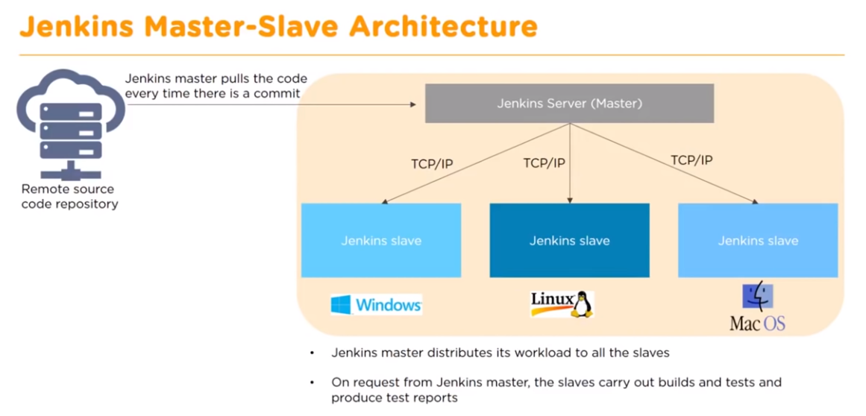
Notes:
Master Machine:
===========
Create ssh key on ec2-user home – ssh-keygen
cat ~/.ssh/id_rsa == > copy and keep it
cat ~/.ssh/id_rsa.pub == > copy and keep it
cat id_rsa.pub >
Slave Machine:
==========
cat >> ~/.ssh/authorized_keys == > paste the public key
Manage Nodes & cloud -- > Create a new node -- > name it == > slave_node permanent node == > ok
Remote root directory -- > /home/ec2-user
launch method : Launch via SSH == > Host == > slave ip address == > credentials == > add == > ssh user name with private key == > user name = ec2-user
private key == > enter directly and paste (no space)
host key verification strategy : Manually trusted key verification strategy == rest as is == check log

Slide 16
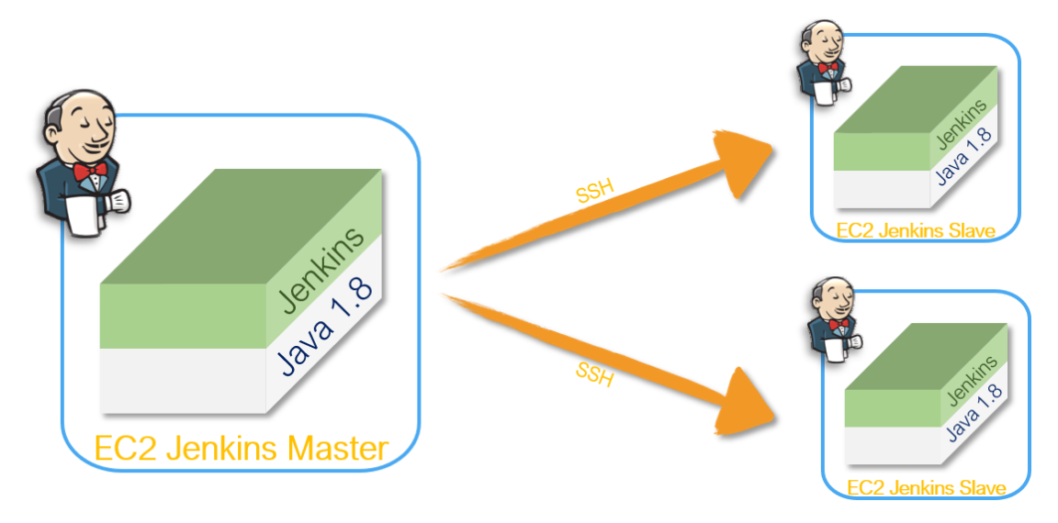
Notes:
https://github.com/miztiik/DevOps-Demos/tree/master/setup-jenkins-slave
Distributed Architecture :
----------------------------
Manage Jenkins -- > Manage Nodes -- > new node -- > name one -- > choose permanent agent -- > ok -- > fill description -- > Remote root directory (/tmp) -- > Labels (linux_slave) -- > use as much as possible -- > Launch agents via SSH -- > Host -- > Private ip of slave node -- >
Manage Jenkins -- > configure global security -- > Agents -- > save random -- > Back to slave configure -- > Launch Method -- > Launch agent by connecting to master -- > availability -- > keep online as much as possible -- > save
Setup Jenkins Slave
-----------------------
# Create user and add the user to wheel group
useradd jenkins-slave-01
# Create SSH Keys
sudo su - jenkins-slave-01
ssh-keygen -t rsa -N "" -f /home/jenkins-slave-01/.ssh/id_rsa
# The private and public keys will be created at these locations `/home/jenkins-slave-01/.ssh/id_rsa` and `/home/jenkins-slave-01/.ssh/id_rsa.pub`
cd .ssh
cat id_rsa.pub > authorized_keys
chmod 700 authorized_keys
Configuration on Master
-------------------------------
mkdir -p /var/lib/jenkins/.ssh
cd /var/lib/jenkins/.ssh
ssh-keyscan -H SLAVE-NODE-IP-OR-HOSTNAME >>/var/lib/jenkins/.ssh/known_hosts
# ssh-keyscan -H 172.31.38.42 >>/var/lib/jenkins/.ssh/known_hosts
chown jenkins:jenkins known_hosts
chmod 700 known_hosts

Slide 17
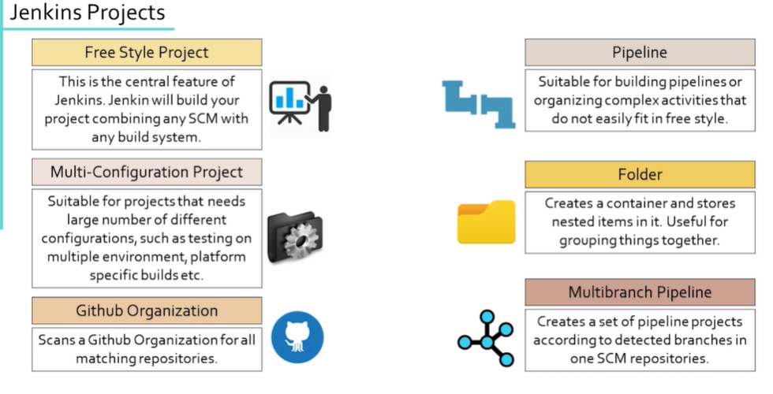
Notes:
Configure Global Security -- > Matrix based Security -- > Admin -- > Full privilege
Manage Users -- > Create User -- >
Manage Jenkins -- > Global Securities -- >
Now try job specific permission :

Slide 18
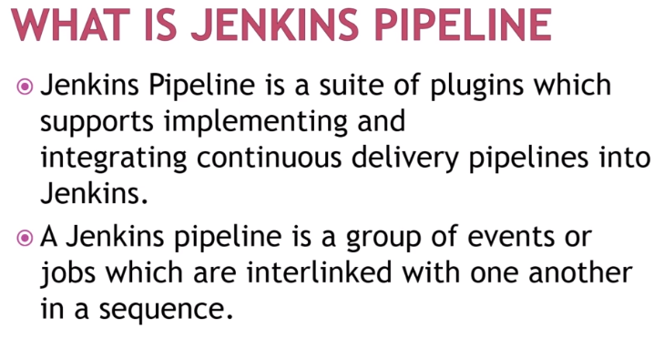
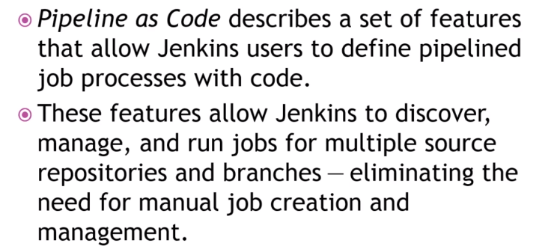
Notes:
https://jenkins.io/doc/pipeline/tour/getting-started/
Groovy String interpolation :
=====================
Under configuration of a pipeline project -- > chose pipeline tab -- >
Write pipe line script -- >
node {
def name =“vikas”
echo “welcome Jenkins ${name}”
}
Jenkins:
=====================
Pipeline-syntax
Sample step = tool:Use a tool from a predefined Tool installation
Then choose maven == > generate pipeline script
node {
stage(‘SCM Chekout’){
git ‘https://github.com/javahometech/myapp’
}
stage(‘Compile package ’){
// Get Maven home path
def mvnHome = tool name: ‘maven-3’ , type: ‘maven’
sh “${mvnhome}/bin/mvn package
}
stage(‘Email notification’){
take from below copy
}
}
Save and build .
Email on Jenkins:
=====================
Google “ gmail smtp settings”
under configure -- > E-mail notification :
SMTP Server = smtp.gmail.com
Use SMTP authentication user name and password
Check SSL
SMTP PORT = 465
Sample step : mail :Mail -- > give details and the generate script
copy this content

Slide 19
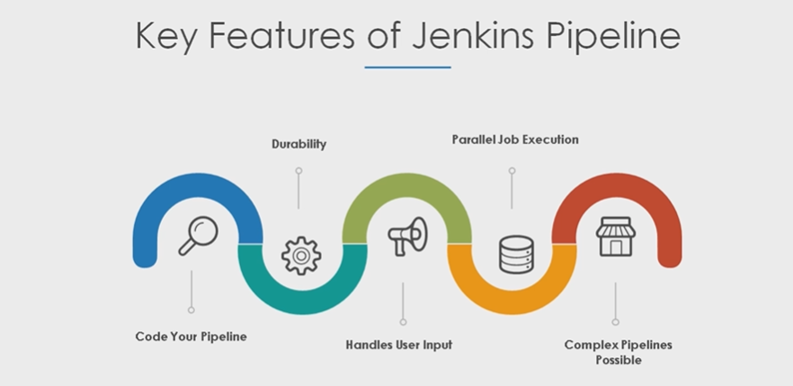

Slide 20
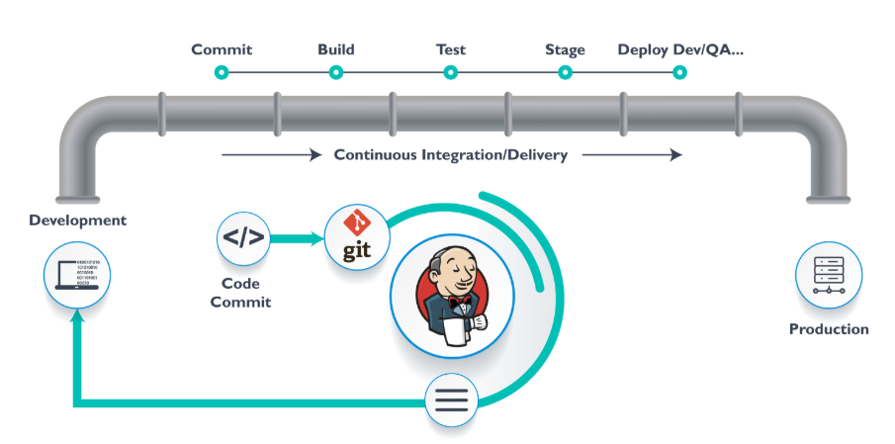
Notes:
Configure Global Jenkins Server Security | Securing Jenkins Server
Click on your name at the top right -- > configure -- > change default password if not done -- > apply .
Go ahead -- > /var/lib/jenkins -- > ls –s secrets -- > rm –rf initialAdminsPassword .
Manage Jenkins -- > Configure Global security -- > Enable security -- > Jenkins own user DB -- > Project based Matrix Authorization Strategy -- >
Configure Global Jenkins Server Security | Securing Jenkins Server
===========================================
Manage Jenkins -- > Manage users -- > Create users -- >
Install plugin -- > Role based Authorization Strategy
Manage Jenkins -- > Manage & Assign Roles -- > Mange Roles -- > Create Roles -- > Assign Roles -- > Apply

Slide 21
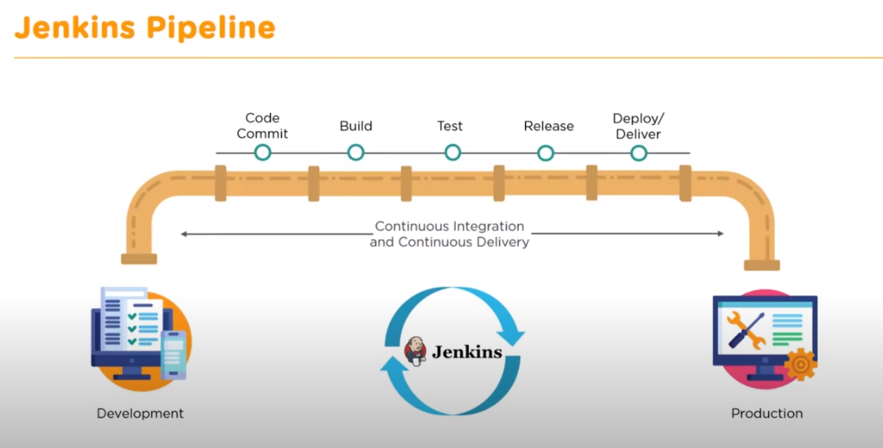
Is a suite of plugins which supports implementation and integration continuous delivery pipeline into Jenkins .
JENKINS PIPELINE
Notes:
Adding Linux Slave to Jenkins Master :
=========================
Manage Jenkins -- > Manage Nodes -- > new node -- > name one -- > choose permanent agent -- > ok -- > fill description -- > Remote root directory (/tmp) -- > Labels (linux_slave) -- > use as much as possible -- > Launch agents via SSH -- > Host -- > Private ip of slave node -- >
Login to slave and master both :
useradd user1
passwd user1
vim /etc/ssh/sshd_config -- > set password Authentication as yes -- > systemctl restart sshd
in master -- > ssh-keygen -- > get ip address of slave machine by -- > ip addr show
copy ket from master to slave -- > ssh-copy-id –i user1@<ip of the slave machine > -- > give yes and the password -- >
Fill host details in slave machine in Jenkins web .
Host key Verification Strategy : Manual trusted key verification strategy
choose tools location -- > install them on slave machine
cd /tmp -- > if files are copied
cd workspace -- > if project is copied
cd .. /tools -- > installed tools

Slide 22
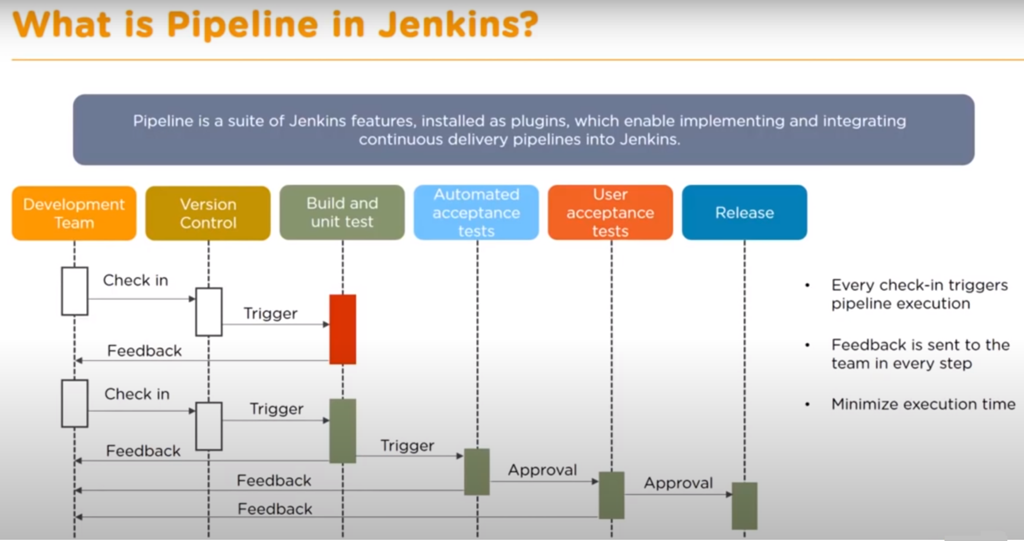
Notes:
Install Delivery Pipeline plugin –
<ip-address>:8080/env-vars.html/
echo “Running Build number ${env.BUILD_NUMBER} on ${env.JENKINS_URL} ”
Pass parameters to pipeline :
General -- > This project is parameterized -- >

Slide 23
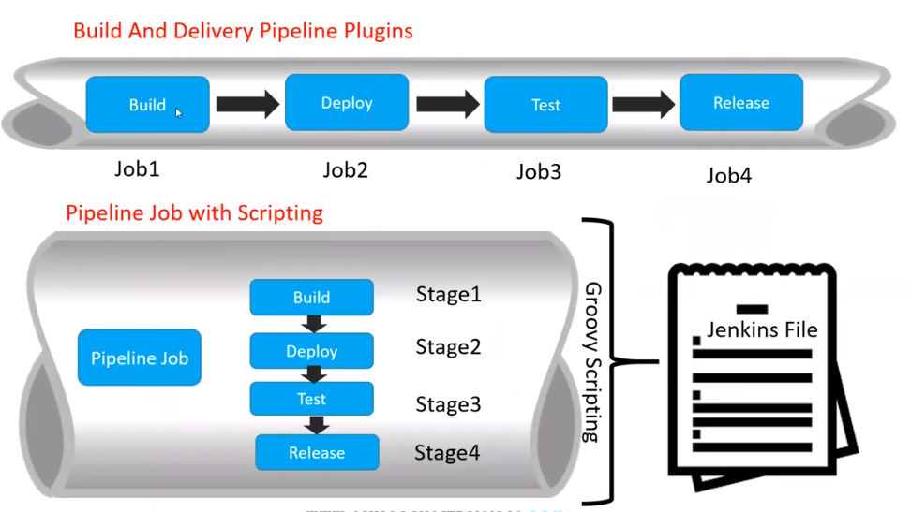
Notes:
https://www.jenkins.io/doc/book/pipeline/
pipeline {
agent any
stages {
stage ('Compile Stage') {
steps {
withMaven(maven : '<Name from Jenkins>') {
sh 'mvn clean compile'
}
}
}
stage ('Testing Stage') {
steps {
withMaven(maven : '<Name from Jenkins>') {
sh 'mvn test'
}
}
}
stage ('Deployment Stage') {
steps {
withMaven(maven : '<Name from Jenkins>') {
sh 'mvn deploy'
}
}
}
}
}

Slide 24
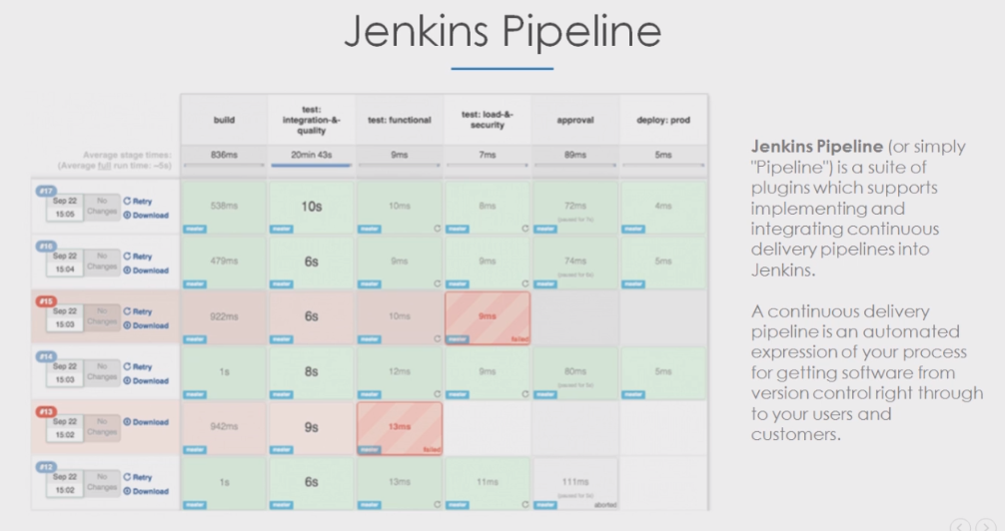
Notes:
Manage pugin -- > SonarQube scanner
Configure Systems -- > Name + url + credentials
Global tool configuration :
https://github.com/vikas99341/spring-petclinic.git
#Required Metadata
sonar.projectkey=simple-java-sonar
sonar.projectName=Simple java sonarQube Project
sonar.projectversion=1.0
#Comma-seprated paths to directories with source (Required)
sonar.sources=src
# Language
sonar.language=java
# Encoding of the source code
sonar.sourceEncoding=UTF-8
Publish Junit test result report:
**/target/surefire-reports/*.xml

Slide 25
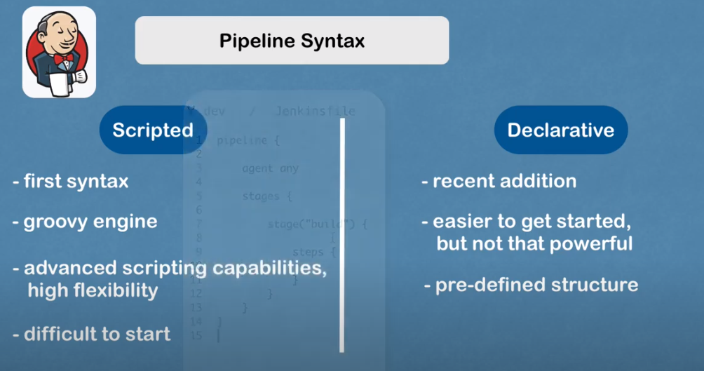
Notes:
Pipeline as code :

Slide 27
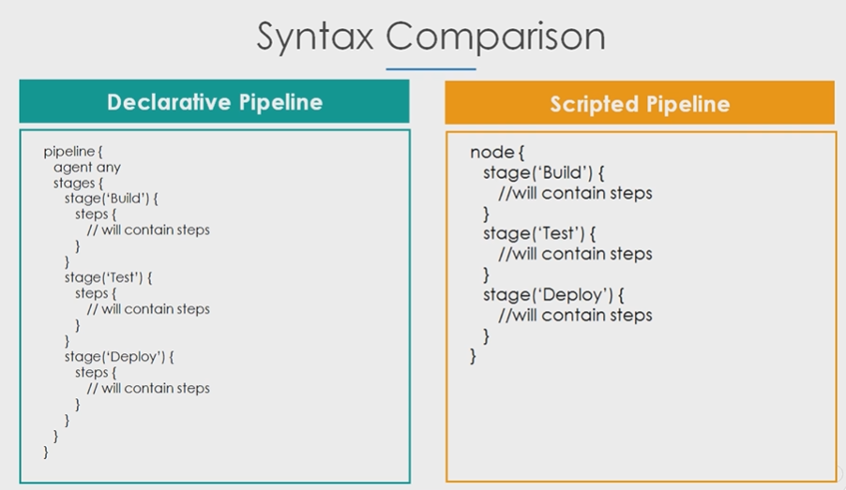
Notes:
Node – Machine on which work is done
Step – Tells Jenkins what to do
Stage – Collection of steps .
Groovy String Interpolation
-----------------------------
node{
def name = “ vikas”
echo “ Welcome to jenkins pipeline ${name]“ ---- > single quotes will not work
https://github.com/vikas99341/my-app/blob/master/Jenkinsfile
}

Slide 28
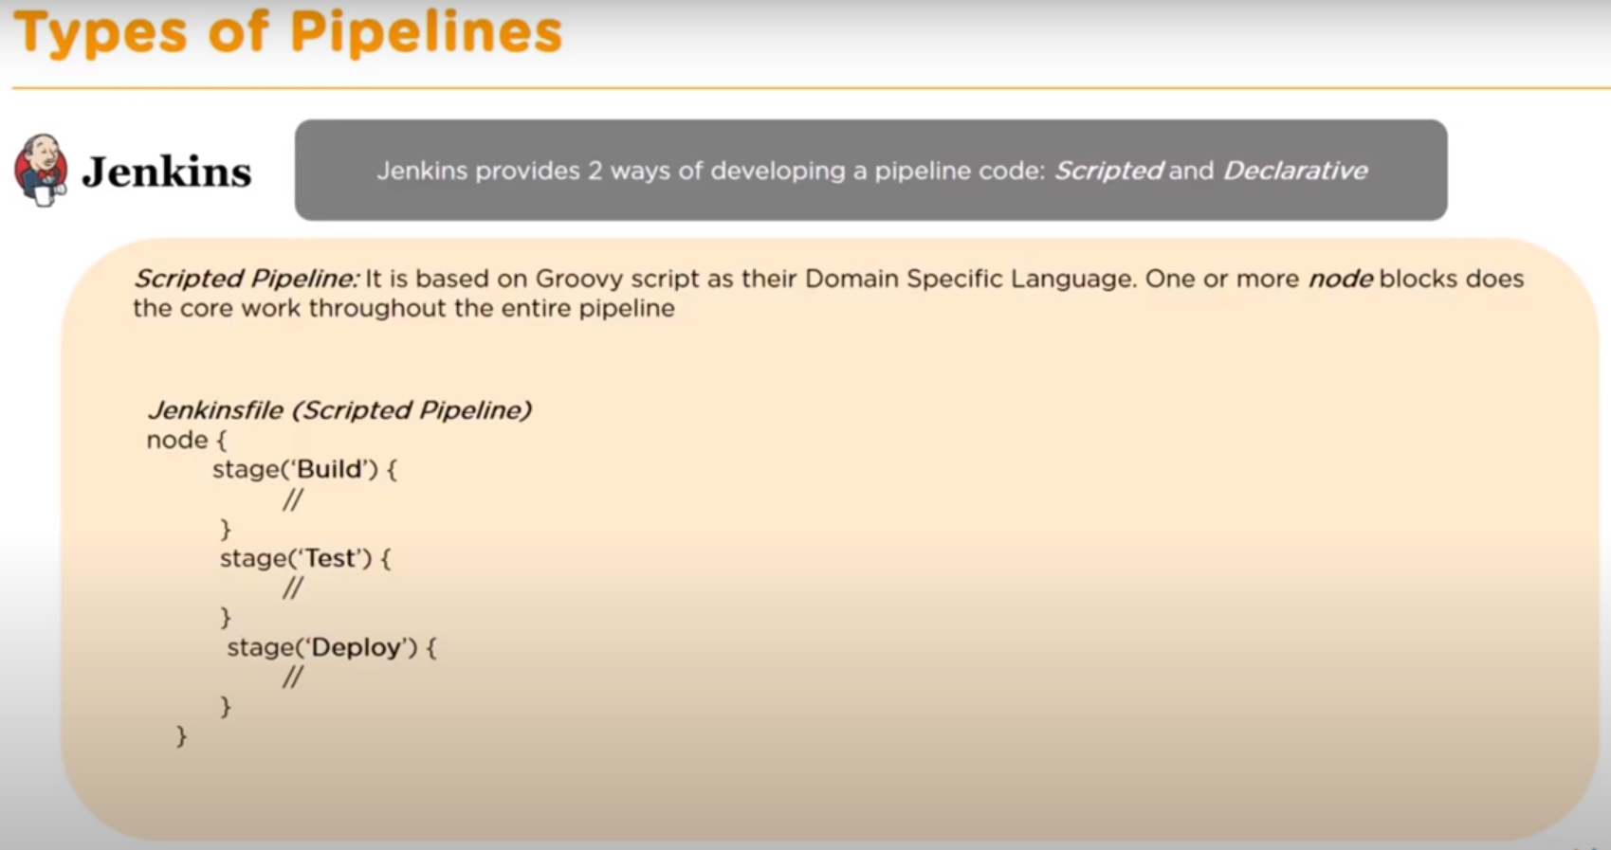
Notes:
node {
def name = “Vikas”
echo “Welcome to Devops ${name} “
}
pipeline{
agent any
stages {
stage("Build"){
step {
echo 'building'
}
}
stage("Test"){
step {
echo 'Testing'
}
}
stage("Deploy"){
step {
echo 'Deploying'
}
}
}
}

Slide 29
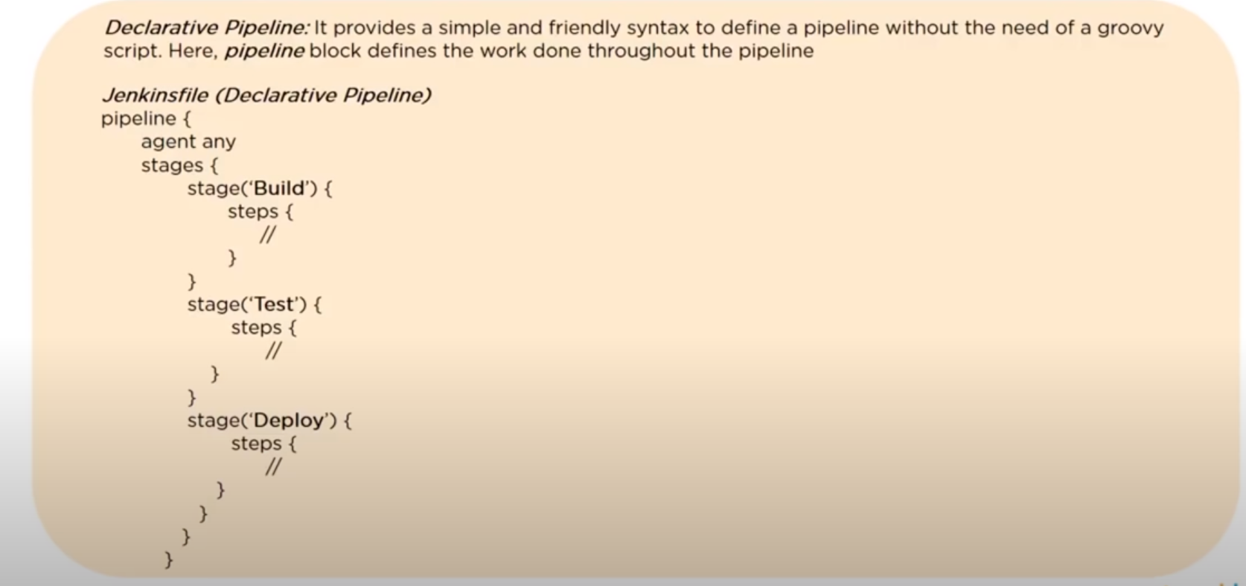
Notes:
node {
stage('SCM Checkout'){
// Clone repo
git 'https://github.com/vikas99341/my-app'
}
stage('Mvn Package'){
// Build using maven
def mvnHome = tool name: ‘maven name ’ , type: ‘maven’
sh “${mvnHome}/bin/mvn clean install package'
}

Slide 30
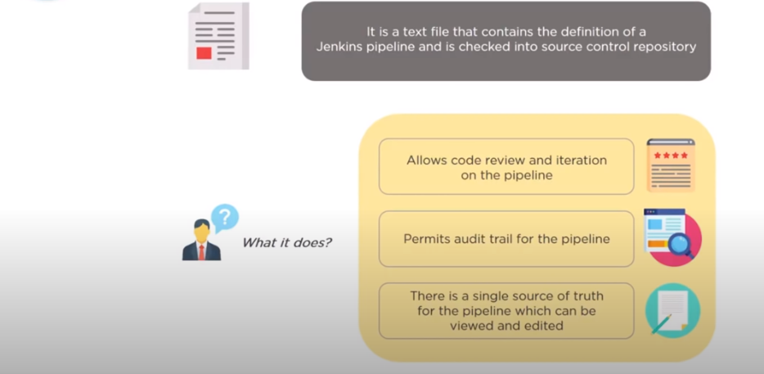
Notes:
To Use Slack use : Slack Notification Plugin :
After that you will see send slack messages

Slide 31
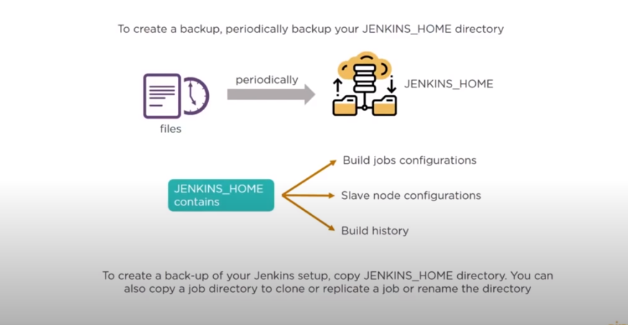
Notes:
pipeline {
agent any
environment {
PATH=“/opt/maven/bin:$PATH”
}
stages{
stage('SCM Checkout'){
step{
git credentialsId: ‘github’ , url : ‘git 'https://github.com/vikas99341/my-app'
}
}
stage('Mvn Package'){
step{
sh “mvn clean package‘
}
}
}
}

Slide 32
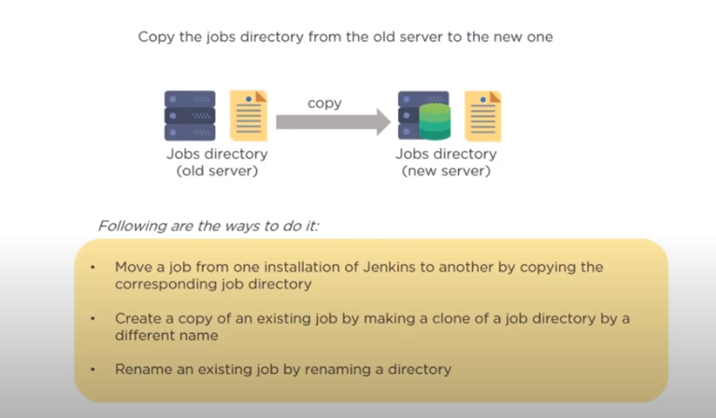
Notes:
Parameter pipeline :
Properties : set job properties -- > this project is parametized -- > choice parameter -- > Branch -- > master ,dev ,qa ,
properties([parameters([choices: ‘master\nfeature\nfeature-2’, description: ‘Select a branch
node{
stage(‘SCM Checkout’){
echo “ Pulling changes from the branch ${params.branch}”
git url: ‘https://github.com/vikas99341/my-app’ , branch: “${params.branch}”
}
}

Slide 33
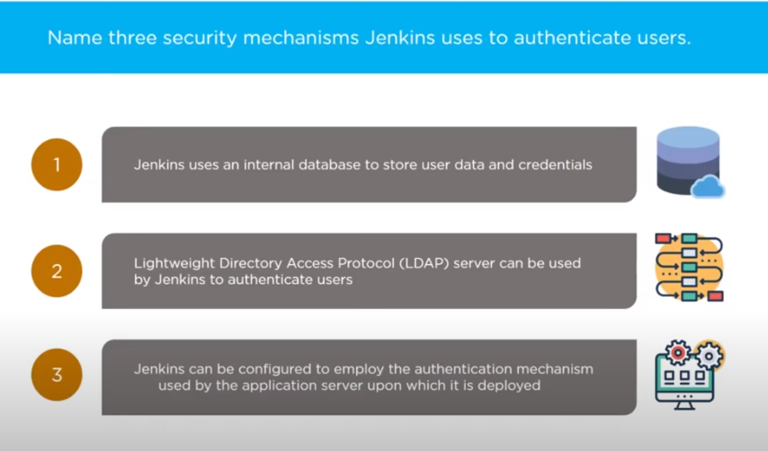
Notes:
Deploy War File to Tomcat Using - Jenkins Pipeline:
---------------------------------------------------------
Install SSH Agent
Script side -- > choose SSH agent

Slide 34
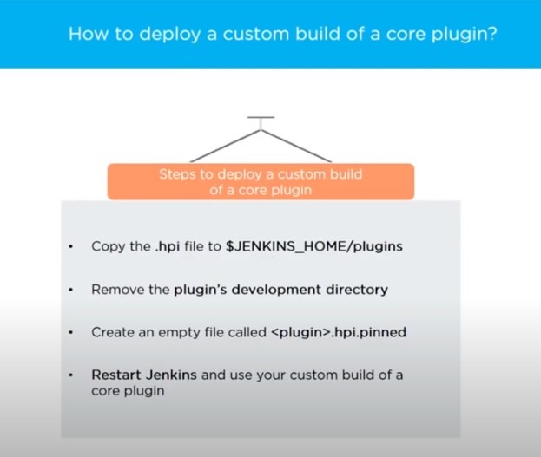

Slide 35
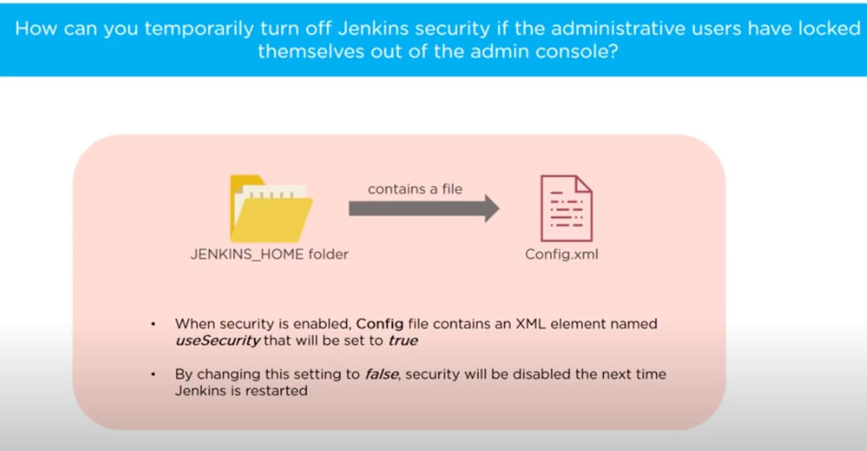

Slide 36
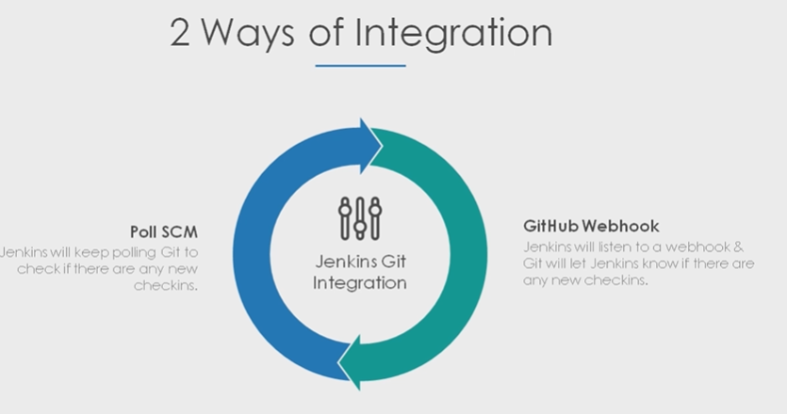

Slide 37
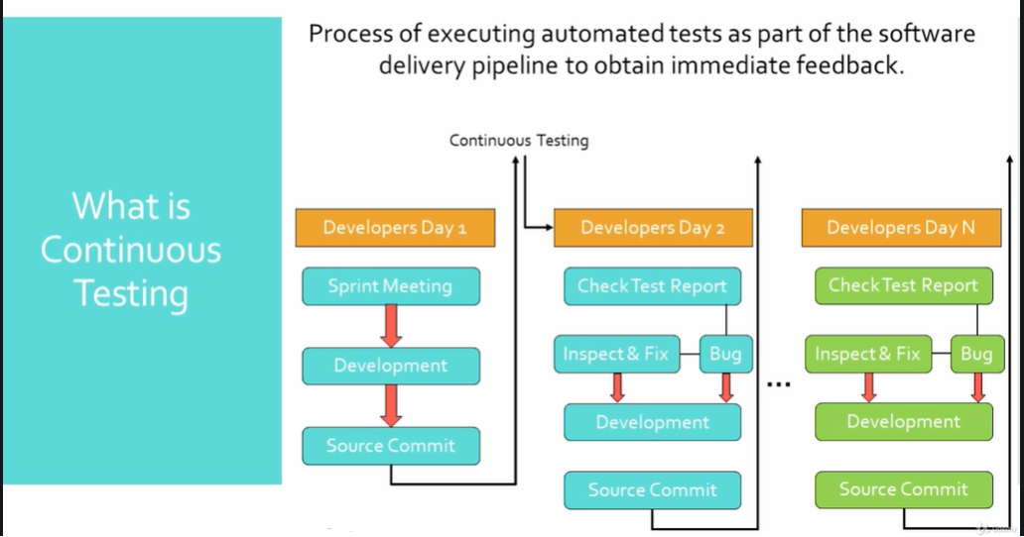

Slide 38
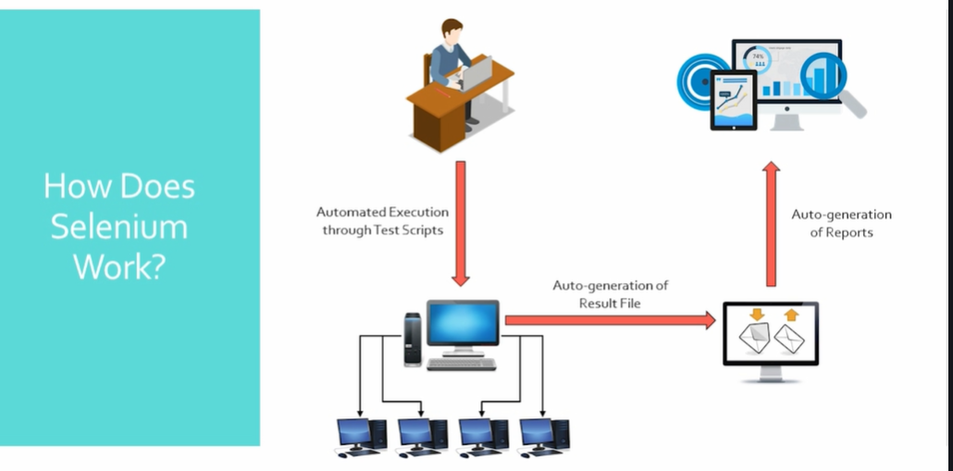

Slide 39
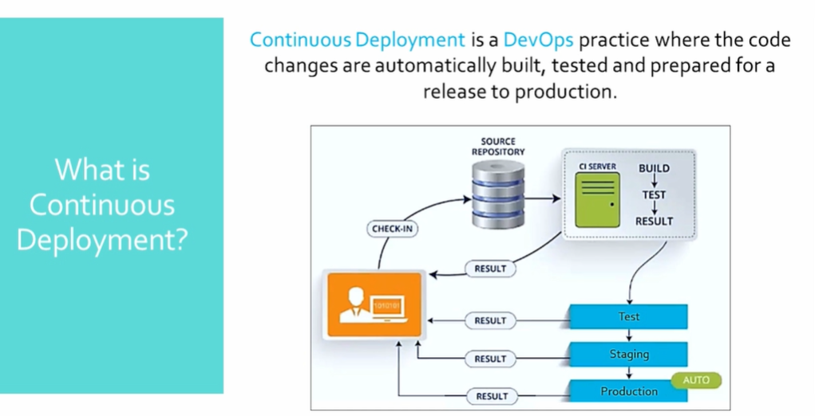

Slide 40
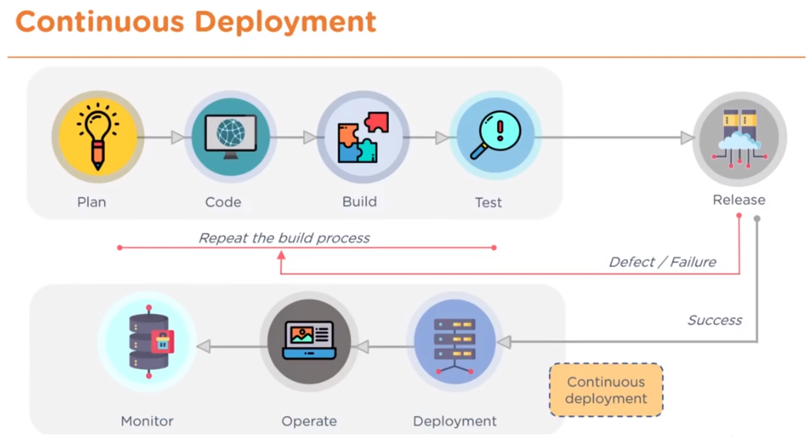

Notes:
Benefits :
Time to market
Complexity
More collaboration

Slide 41
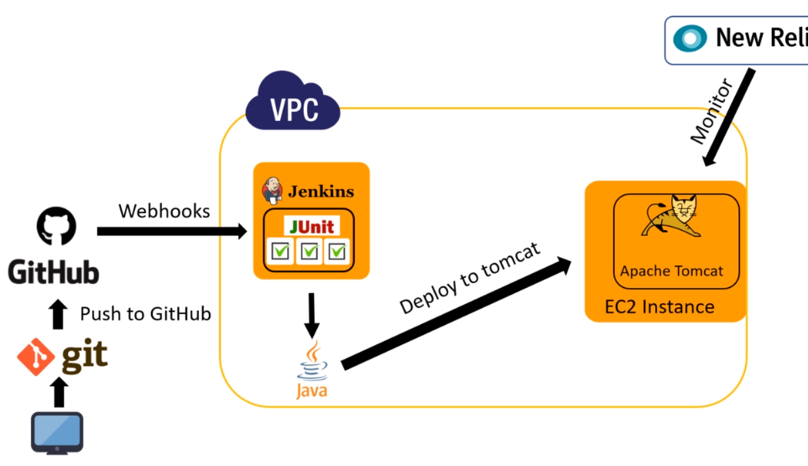
Notes:
Learning is not a race take your time .Add knowledge day by day .Key learning technique is do it yourself .
I have been guiding friends ,colleagues & students on AWS from last five years .I am 5 times certified from AWS so far and counting .Believe me you are with safe hands so you have made a great choice .
If cost is involved I will let you know .Super happy to be with you happy learning
Currently I am following my passion by teaching and help all my students to achieve their goals by upskilling them and stay job ready .
See Junit Test reports:
------------------------
Post build action – test report XML – target/surefire-reports/*.xml

Slide 42
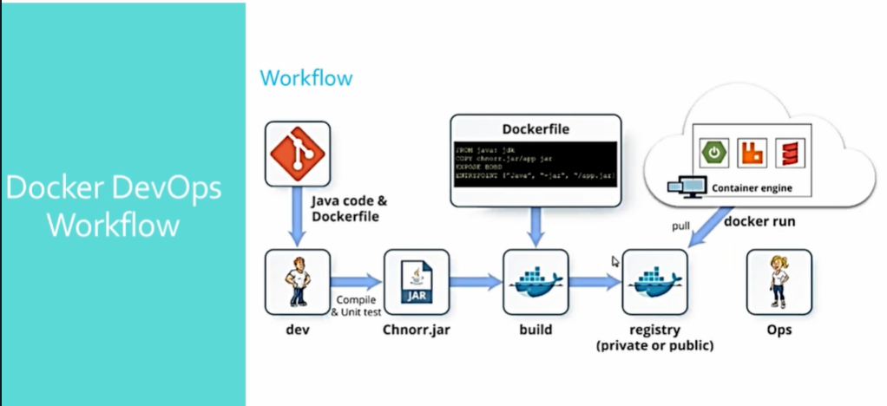

Slide 43
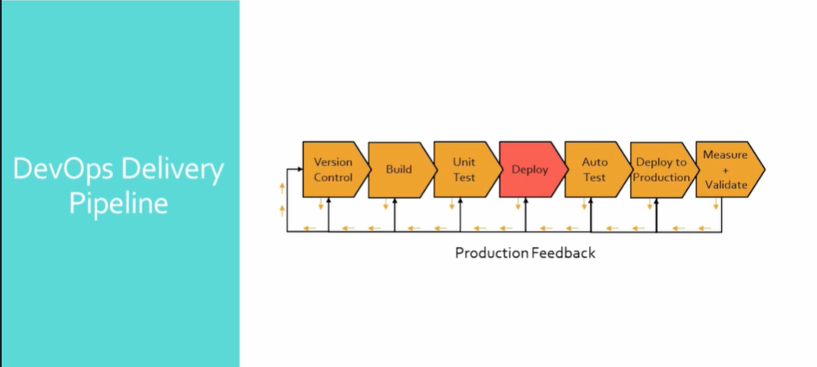
Notes:
Create user and provide them access:
========================
Configure global security :
Yum install tomcat tomcat-webapps tomcat-admin-webapps
vi /usr/share/tomcat/conf/tomcat-users.xml
<user username=“deployer” password=“deployer” roles=“manager-script” />
Install deploy to container plugin == post build action == **/*.war
contextpath can be anything ==mydevopsdeployment
[root@ip-172-31-86-127 conf]# systemctl restart tomcat [root@ip-172-31-86-127 conf]# systemctl enable tomcat

Slide 47
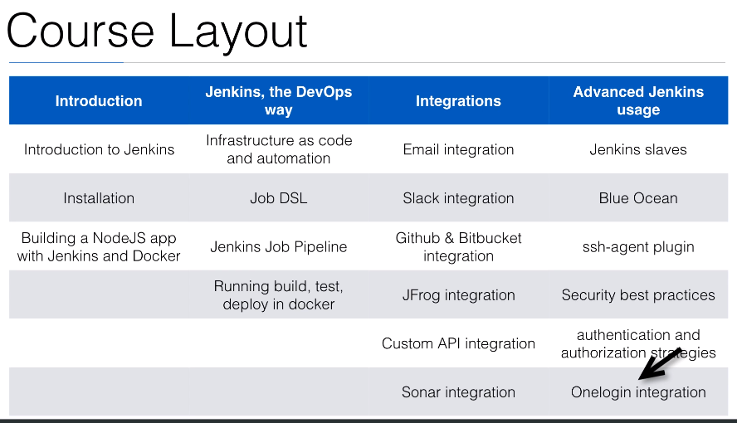
Notes:
https://github.com/wardviaene/jenkins-course
https://github.com/wardviaene/docker-demo

Slide 48
Course Layout
Notes:
Building First docker application:
wardviaene/docker-demo
inside that we have index.js which has express package to respond to http request .
package.json – metadata information
docker file
Create a freestyle project with NodeJS plugin
Cloudbee docker image

Slide 49
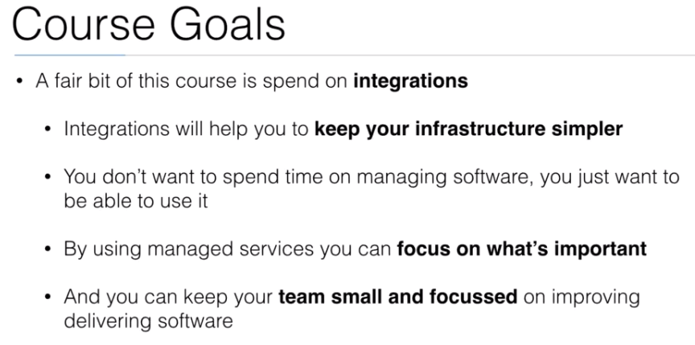
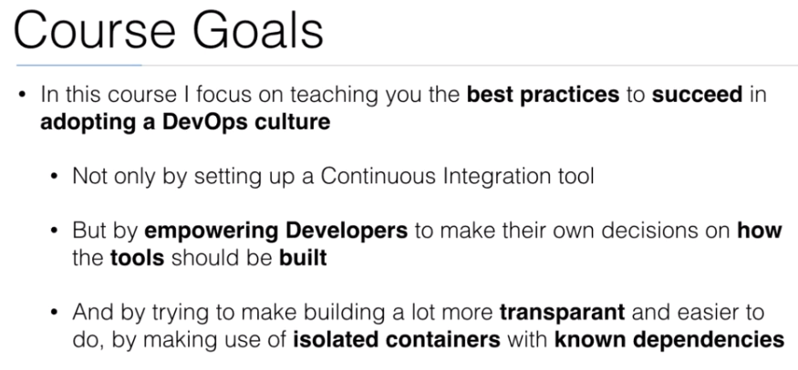

Slide 50
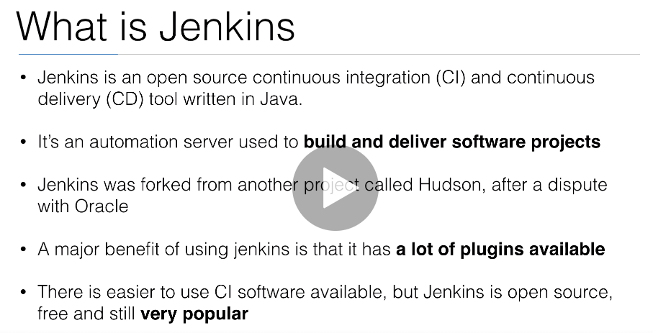

Slide 51
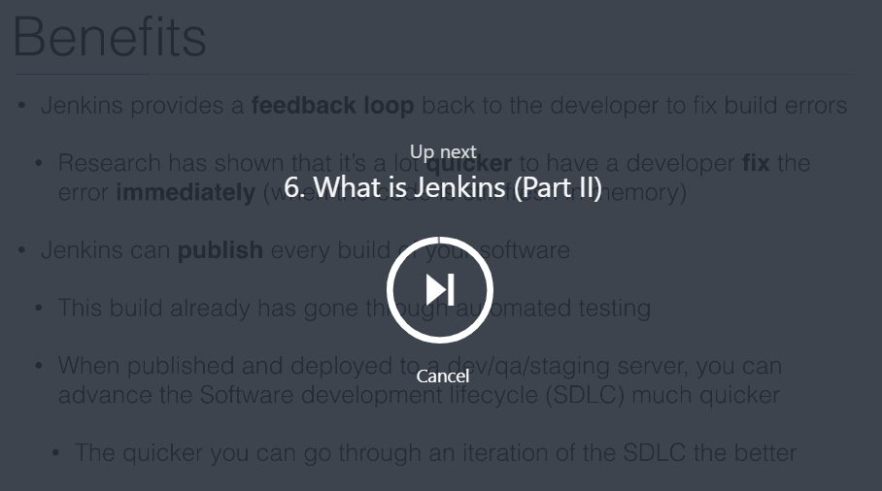
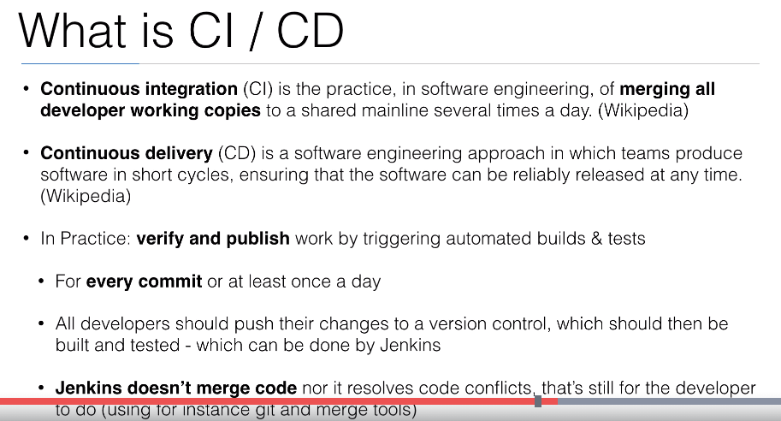

Slide 52



Slide 53

Notes:
Used by companies like paypal and linked in, yahoo .Netflix .
Don’t have to compile and easy to learn

